Slide 1
Introduction to Python Session 1
Notes:
1

Slide 2



Objectives
Appreciate the larger phenomenon of Open Source Software (OSS)
Understand what programing languages like Python mean
Introduce some of the basic programing concepts
Notes:
Results of first essay is close to complete
2

Slide 3
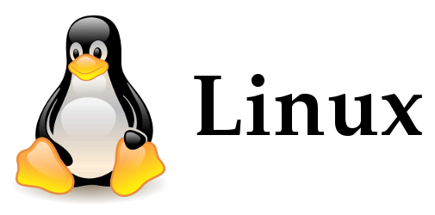

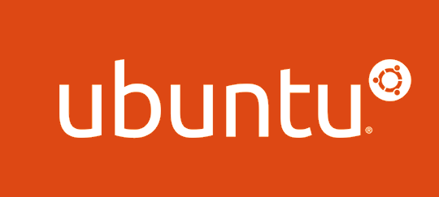
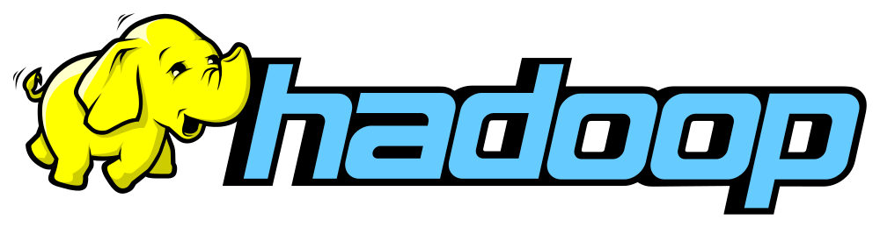
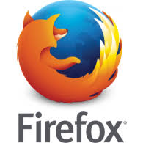

Open Source Software
Free and open source software
Source code is made available to everyone
Free as in freedom
A brief history
1960 to 1980: Academic setting with high autonomy
UNIX at Bell Labs
1980 to 1990s:Formalization of OSS
UNIX commercialised by AT&T
Richard Stallman creates FSF and GNU licence
Eric Raymond creates OSI
Post 1990: Organizations embrace OSS
2001 IBM opens its 40$mn software – eclipse software foundation
2016 Google has started over 900 OSS projects
Best Examples – Linux, Apache, Python
Notes:
Platforms
3

Slide 4
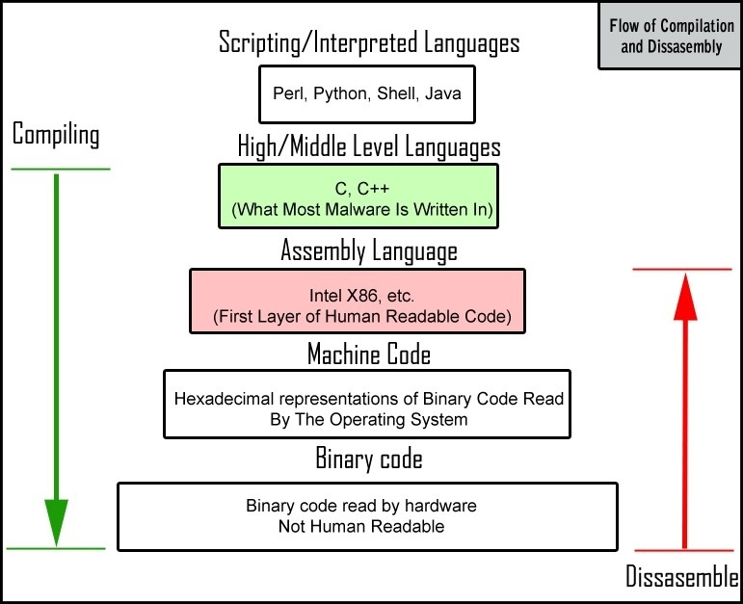
Programming Language
Alan Turing and computing
Formalizing the concept of algorithm and computation with the Turing Machine
Stored program computer – treat algorithms as data
Programming language
It is how we communicate with machines
From GUI to Machine level language
Syntax
A set of rules that define how the programming language is written
Grammar of programming language
Notes:
Platforms
4

Slide 5
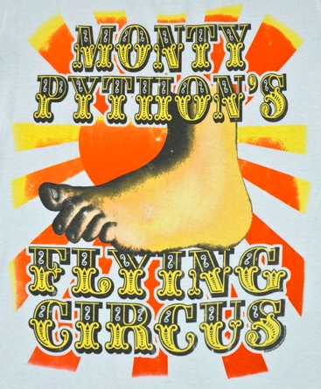
Python
Simplicity
High level language built on C
Benefits of being high level and at the same time provides for CPU-efficient code
Usability
Lots of documentation
Active development community to answer questions - stackexchange
Extensibility
Small core language with a large standard library and an easily extensible interpreter
Leverage OSS community by allowing for extensibility
Notes:
Platforms
5

Slide 6
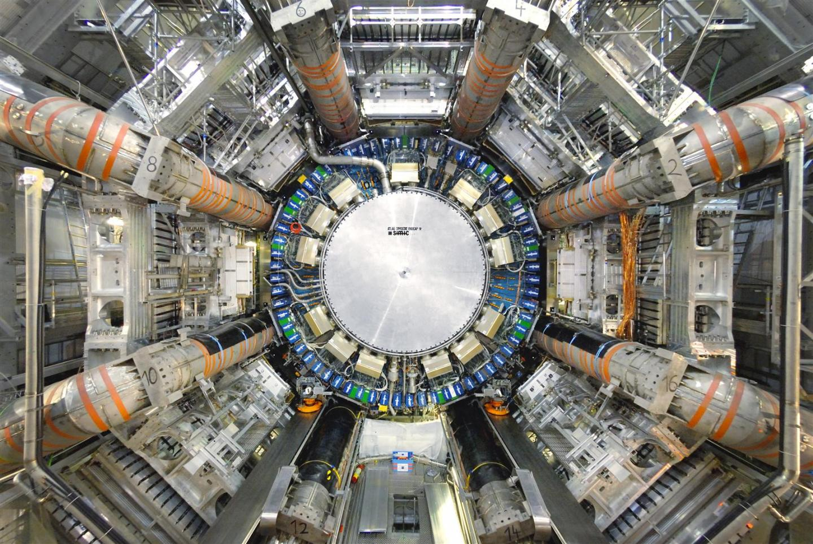
Python for BIGDATA
Big data management using Python
CERN and Large Hadron Collider
Particle detector (Atlas)
Data equivalent to 100 Megapixel camera taking 40 million pictures a second
Needle in a haystack – couple quadrillion collisions to find 1000 collisions that results in Higgs Boson
Pre-process this stunning amount of data in real time and store only the relevant for further analysis
Notes:
Platforms
6

Slide 7
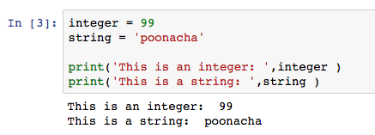
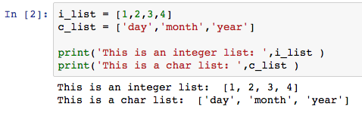
Programming Concepts- Data types
Data types - Integer, float, string and boolean
Data structures – lists, dictionaries and tuples
Data structures combine the basic datatypes (integer, float, string, boolean) to create more complex types
Mutable vs. immutable
Data frame - "tabular" data: a data structure representing cases (rows), each of which consists of a number of measurements (columns).
Notes:
Not just a logical procedure that takes input data, processes it, and produces output data
The concept of a data frame comes from the world of statistical software used in empirical research; it generally refers to "tabular" data: a data structure representing cases (rows), each of which consists of a number of observations or measurements (columns).
A mutable object can be changed after it's created, and an immutable object can’t.
If you want to write most efficient code, you should be the knowing difference between mutable and immutable in python. Concatenating string in loops wastes lots of memory , because strings are immutable, concatenating two strings together actually creates a third string which is the combination of the previous two. If you are iterating a lot and building a large string, you will waste a lot of memory creating and throwing away objects. Use list compression join technique.
Python handles mutable and immutable objects differently. Immutable are quicker to access than mutable objects. Also, immutable objects are fundamentally expensive to "change", because doing so involves creating a copy. Changing mutable objects is cheap.
7

Slide 8
Programing Concepts- OOP
Functional vs. object oriented programming
Object Oriented Programming (OOP)
Data over actions
What we really care about are the objects we want to manipulate rather than the logic required to manipulate them
Classes and objects
Notes:
Not just a logical procedure that takes input data, processes it, and produces output data
The concept of a data frame comes from the world of statistical software used in empirical research; it generally refers to "tabular" data: a data structure representing cases (rows), each of which consists of a number of observations or measurements (columns).
8

Slide 9
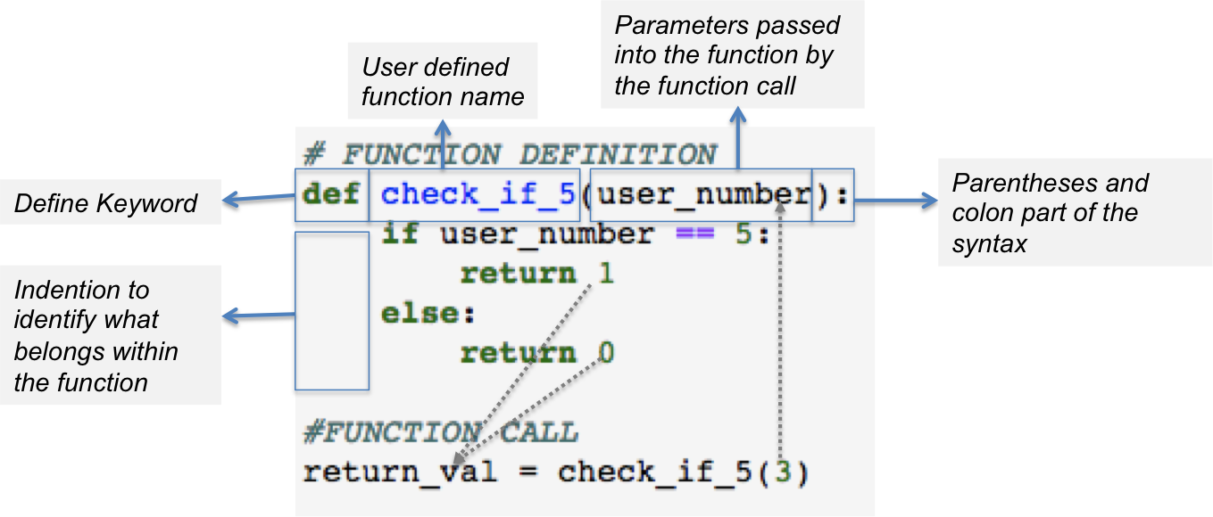
Programing Concepts – FUNCTIONS AND MODULES
Block of organized, reusable code that is used to perform a single, related action
Provide better modularity for your application and a high degree of code reusing
Python gives you many built-in functions like print(), len() etc..
It is also possible to define user-defined functions
Module : A set of related functions can be grouped together as module
The open source community continuously builds modules and makes it available for us
To access these modules we need to use the "import command” eg. import random
Notes:
Not just a logical procedure that takes input data, processes it, and produces output data
9

Slide 10
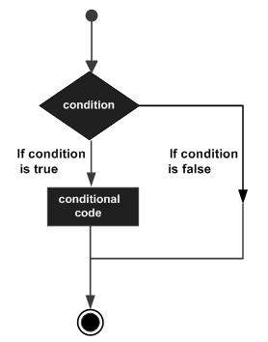
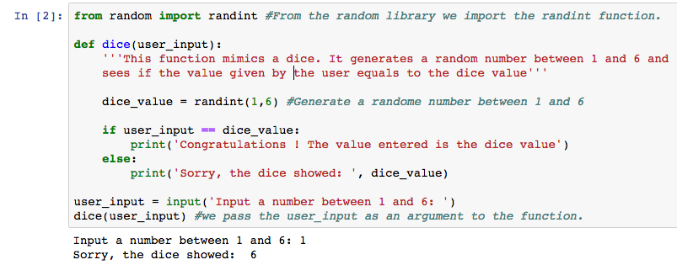
Programing Concepts – CONDITIONS AND CONTROLS
Evaluate expressions which produce TRUE or FALSE as outcome
Based on the outcome of the expression a specific block of code is executed
The expressions could be: equality (==) , inequality (!=), less/greater than (<)(>), less/greater than or equal (<=) (>=), membership (in, not in)
Expressions can be combined using "and" and "or" and "and not"
Notes:
Not just a logical procedure that takes input data, processes it, and produces output data
10

Slide 11
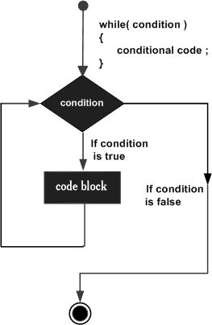
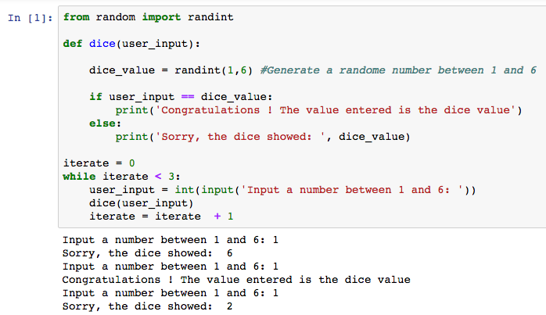
Programing Concepts - LOOPS
A loop statement allows us to execute a statement or group of statements multiple times
While loop is the simplest loop which executes a block of code until and expression is True
A 'break' command can be used to exit any loop prematurely
A 'continue' command can be used to skip ahead to the next iterations without exiting the loop
Notes:
Not just a logical procedure that takes input data, processes it, and produces output data
11

